Slide 1

Unreal engine advnced
Git Submission work flow

Slide 2

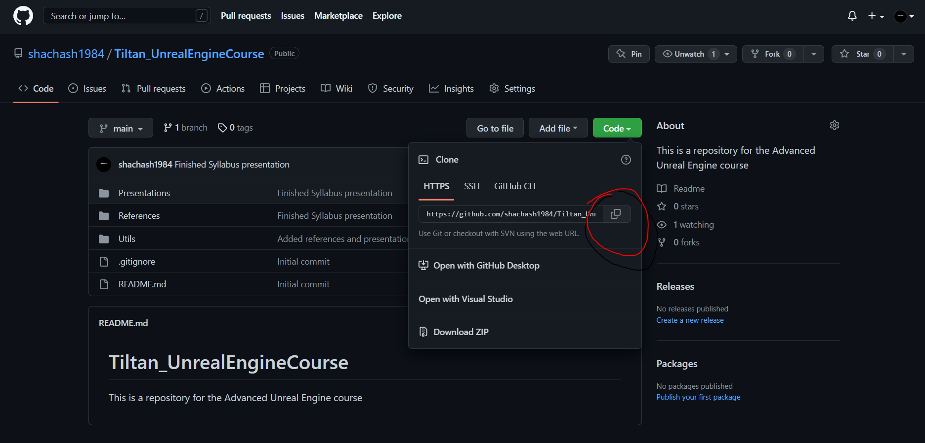
Cloning the Course repo
This Photo by Unknown Author is licensed under CC BY
This Photo by Unknown Author is licensed under CC BY-NC

Slide 3
Cloning the Course repo
This Photo by Unknown Author is licensed under CC BY

Slide 4

Moving to another branch
This Photo by Unknown Author is licensed under CC BY

Slide 5

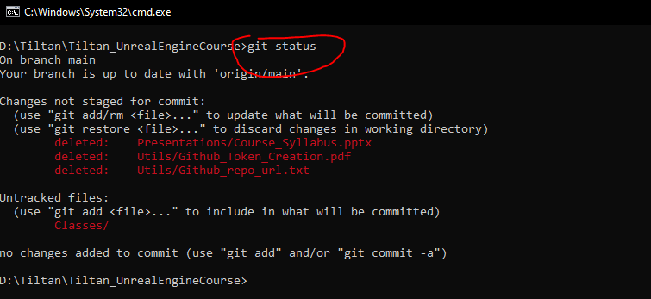
Checking current status
Local Machine
Red lines are “Unstaged” Changes, AKA: “Working tree changes”
***NOTICE***
On the second line it states your current branch, on your case it should be: “On branch FirstName_LastName”
This Photo by Unknown Author is licensed under CC BY

Slide 6
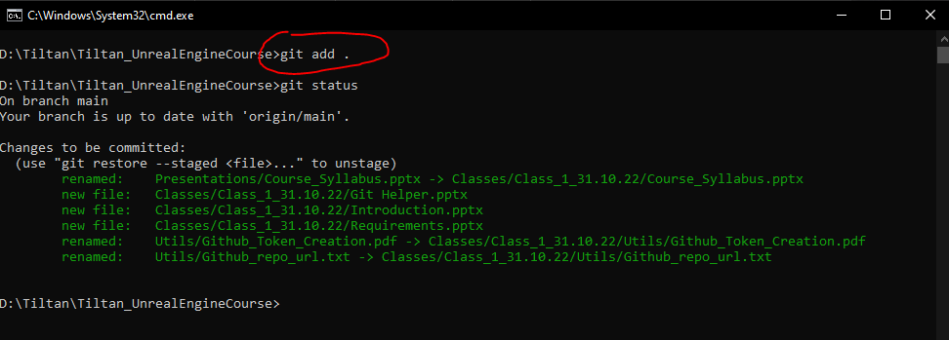
Staging your Changes
Local Machine
To stage changes we use the command: “git add [FILE/FOLDER]”
The “.” stands for current directory (which, in this case, is the root directory of the repo)
After running “git status” again we can see the lines became green – this means they are staged
Changes are now ready to be committed
Changes are now staged on YOUR LOCAL MACHINE
This Photo by Unknown Author is licensed under CC BY

Slide 7
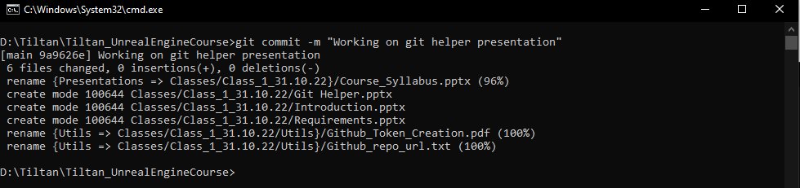
Committing your Changes
Local Machine
To commit changes we use the command: git commit –m “comments…”
These changes are now committed on YOUR LOCAL MACHINE
This Photo by Unknown Author is licensed under CC BY

Slide 8
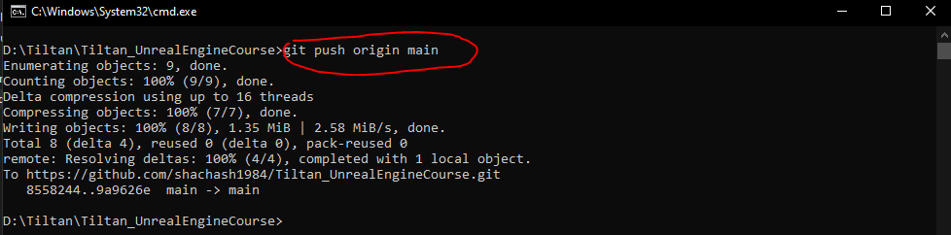
Pushing your changes to the server
Local Machine
Remote Server
After we commit changes, we need to sync the remote repo (the one on github…)
***NOTICE***:
This might require using a GitHub token. Instructions are in here:
“Tiltan_UnrealEngineCourse\Classes\Class_1\Utils”
This Photo by Unknown Author is licensed under CC BY

Slide 9
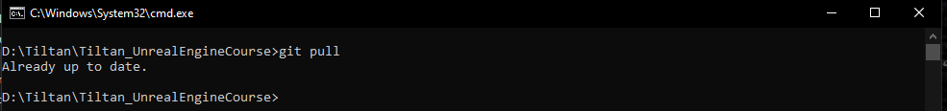
Pulling Other’s changes from the server
Remote Server
Local Machine
The command “git pull” downloads changes in the server version of the repo to our local repo
***WARNING***
Before “pulling”, make sure you have staged, committed, and pushed all your changes. Otherwise your branch might need a bit of work to be synced again
The changes you are pulling should be on other branches and not your own (probably the “main” branch or “Other_Person”’s branch
This Photo by Unknown Author is licensed under CC BY

Slide 10
Merging the Main Branch to your branch
Local Machine
Local Machine
The command “git pull” downloads changes in the server version of the repo to our local repo
***WARNING***
Before “pulling”, make sure you have staged, committed, and pushed all your changes. Otherwise your branch might need a bit of work to be synced again
The changes you are pulling should be on other branches and not your own (probably the “main” branch or “Other_Person”’s branch
This Photo by Unknown Author is licensed under CC BY

Slide 11
Thank you!
Best of luck!

